Slide 1

Team Farthorl
Advanced C# May 2016

Slide 2
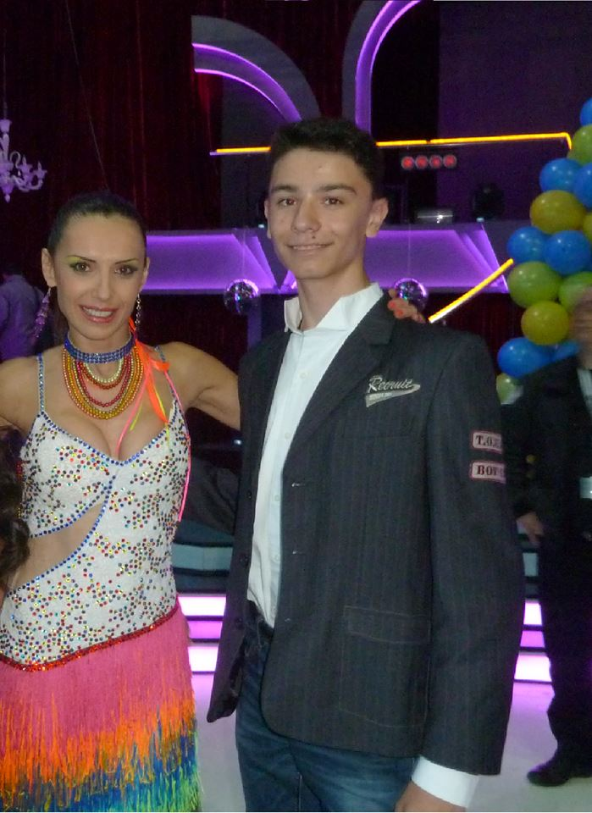
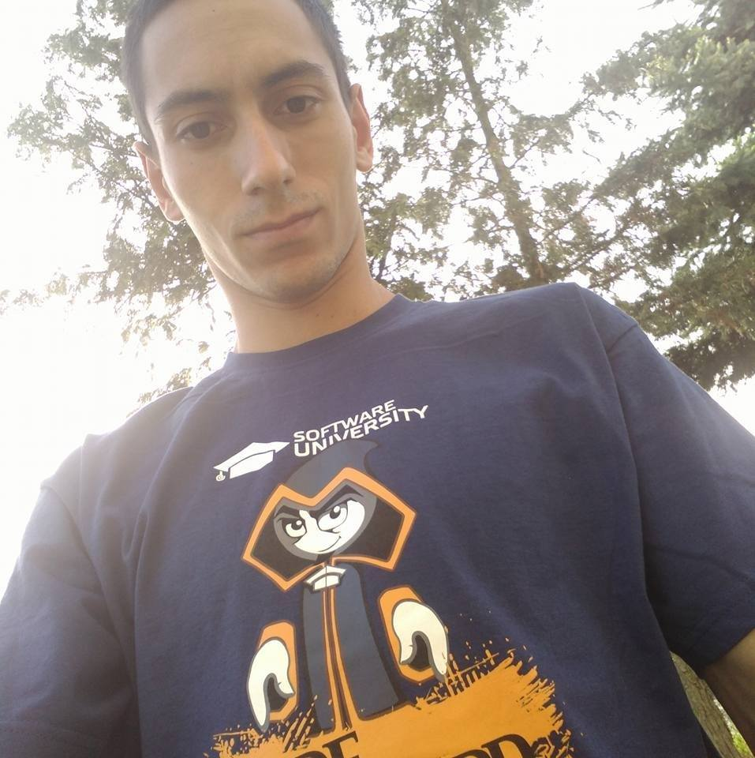






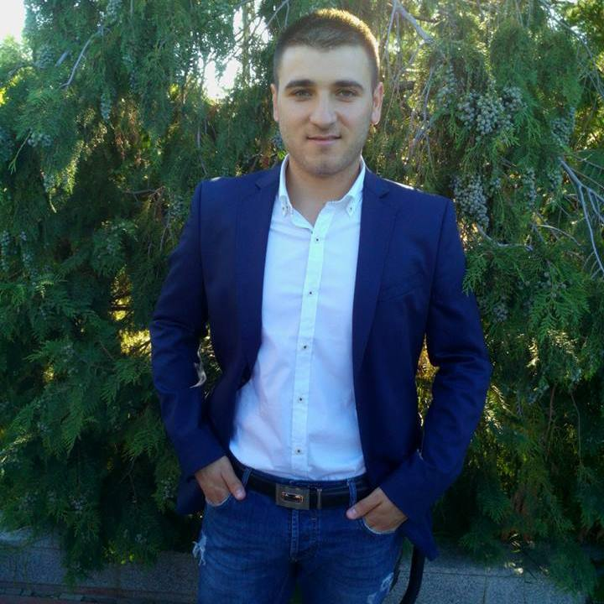

Team Members in alphabetical order :D
GITHUB…

Slide 3
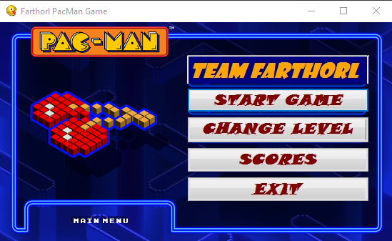
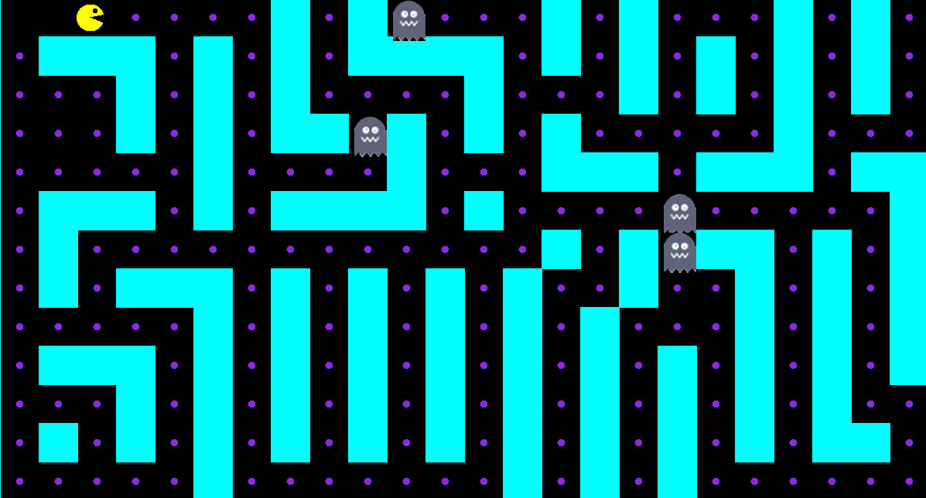
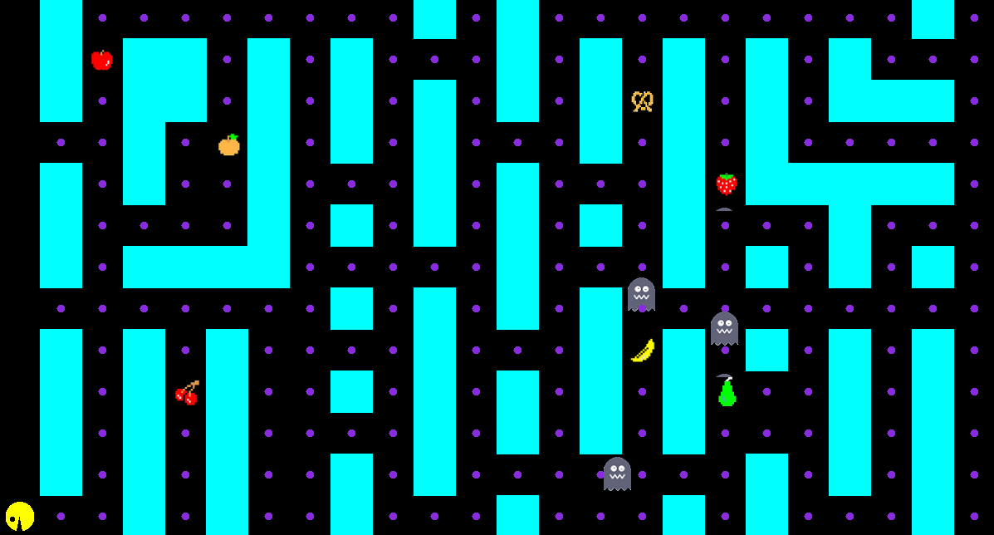
v. 0.0001
v. 0.0003

Slide 4







(Original) Pac-Man Sounds Click the speaker to hear it’s sound
Ready!
Intermission
Eating Dots
Eating Ghost
Eating Fruit
Extra Life
Death

Slide 5
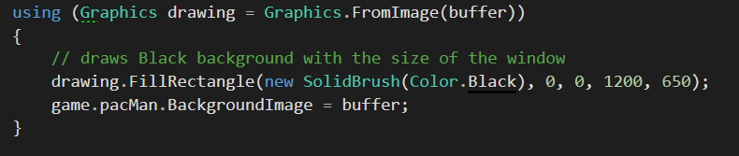
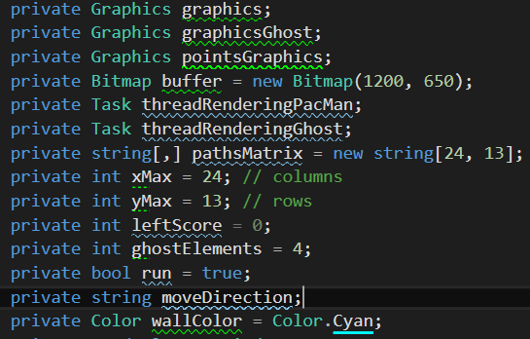
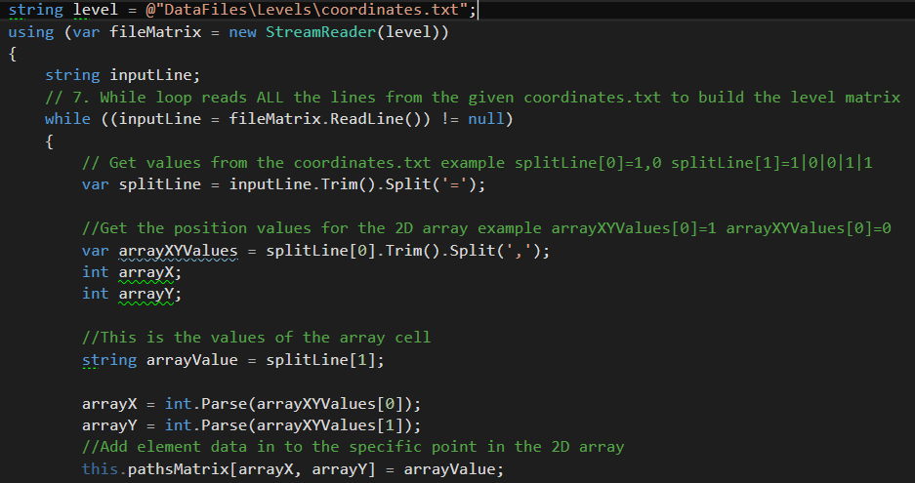
Code Logic Overview
Engine:
Using System.Drawing;

Slide 6
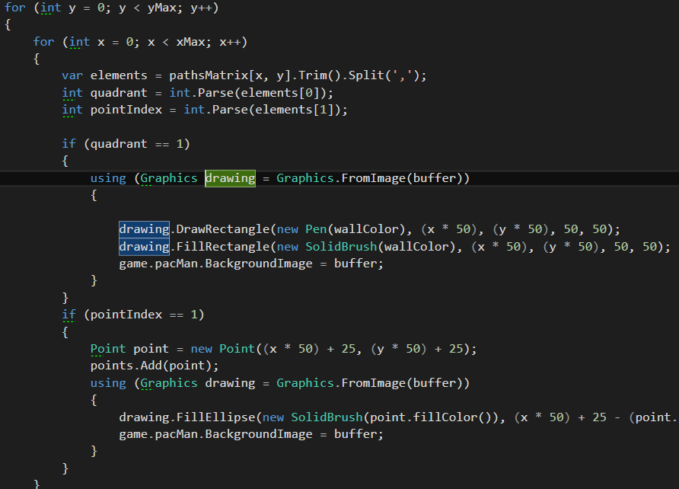
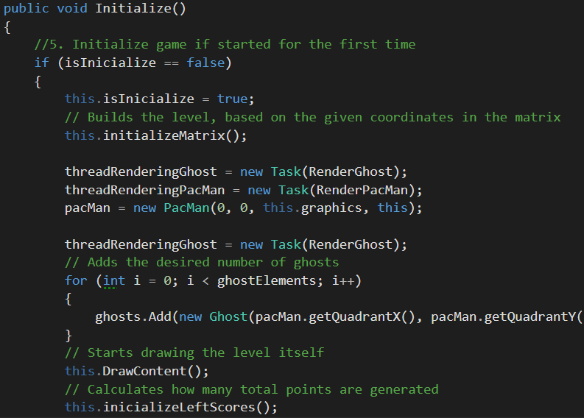
And the drawing continues…

Slide 7
Main Focus during C# OOP Basics
Encapsulation
Extracting methods
Inheritance / Polymorphism

Slide 8
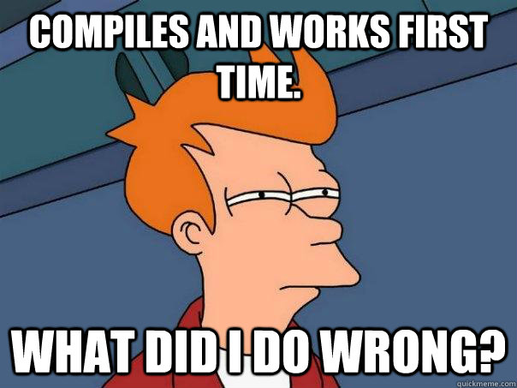
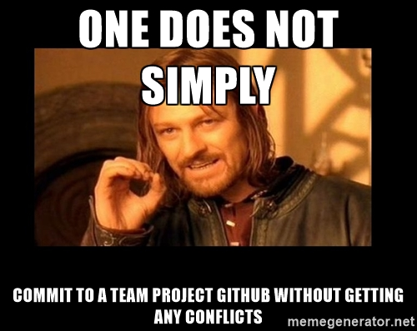
TEAMWORK

Slide 9
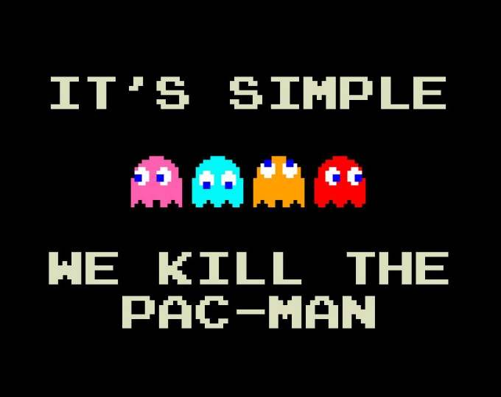

Promises kept:
Some new features implemented:
Reduced CPU usage by around 75% by combining different tasks together
Simplified the gaming logic
Extracted various global constants
Game Menu is now more user-friendly
Added collision detection for enemies
Implemented method to place fruits on random available places on the map

Slide 10
Planned features in the future
Fruits can have random side effects, including :
Stopping the Ghosts for a while
Decreasing Ghost speed
Increase Ghost Population
Increase Ghost Speed
Reverse your keyboard keys
Teleport you to a random location
+ Increased Difficulty Mode with improved Ghost Pathfinding
+ If possible, allow Two-Player Multiplayer on a single screen. Who will gather more points for a period of time?

Slide 11
